Slide 1
Computational Platform for Synthetic Correction of Disease-Causing SNPs: Sickle Cell Disease
Luke Hovagimian, Alexander Leong, Minh Nguyen, Heewon Park
Point of Contact: lukehov@bu.edu
April 22nd, 2026

Slide 2
Goal & Motivations
SNPs contribute to various diseases and health conditions, but current methods focus mainly on detecting these mutations rather than developing therapeutic solutions. A computational framework is needed to identify SNPs and guide personalized genetic correction strategies.
GOAL:
Identifies disease-associated SNPs from patient sequences (HBB)
Generates Clustered Regularly Interspaced Short Palindromic Repeats (CRISPR) based correction strategies
Evaluates guide ribonucleic acid (gRNA) based on efficiency and off-target safety
Notes:
HEEWON

Slide 3

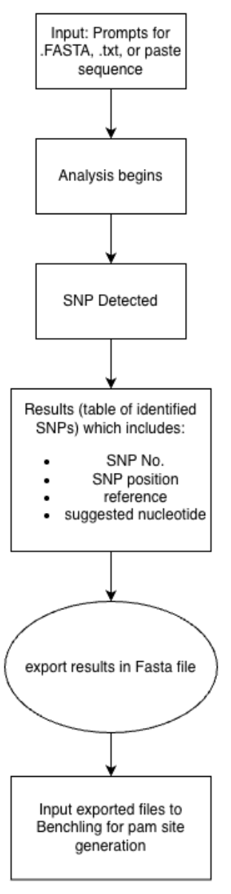



General Functionality Workflow
SNP detection:
user input
determine if SNP is detected or not
shows results including the SNP number, position, reference and suggest nucleotide.
export the results in fasta file
CRISPR gRNA:
Fasta file export
input exported Fasta file to benchling
pam sites generated by benchling
gRNA and CRISPR embedded function
output results similar to the FASTA file are inputted and gRNA design is created
ANALYSIS
RESULTS
Our status

Slide 4
Design Specification
Design | Specification
Input query sequence handling & capacity | Accept FASTA files or manual gene-sequence entry; only valid nucleotide characters (A, C, T, G, N) are allowed; minimum query length: 20 bp
Database handling & safety check | Accept FASTA files or manual gene-sequence entry; only valid nucleotide characters (A, C, T, G, N) are allowed; reject malformed or duplicate records of >99% similarity; database sequence should be longer than the query for reliable alignment
SNP analysis accuracy | Select high-quality alignments using mismatch presence, percent identity, and alignment logic; detect the mutated nucleotide position with 100% accuracy on validated test cases
gRNA Design & Scoring | gRNA design with a valid PAM site, scoring (0-1.0) based on minimal SNP-to-cut-site distance (30%), 40-65% GC content (25%), low homopolymer penalty (15%), and low off-target activity (30%)
GUI intuitiveness | Present inputs, actions, and outputs clearly; complete the workflow in 7 steps or fewer
Notes:
ALEX

Slide 5
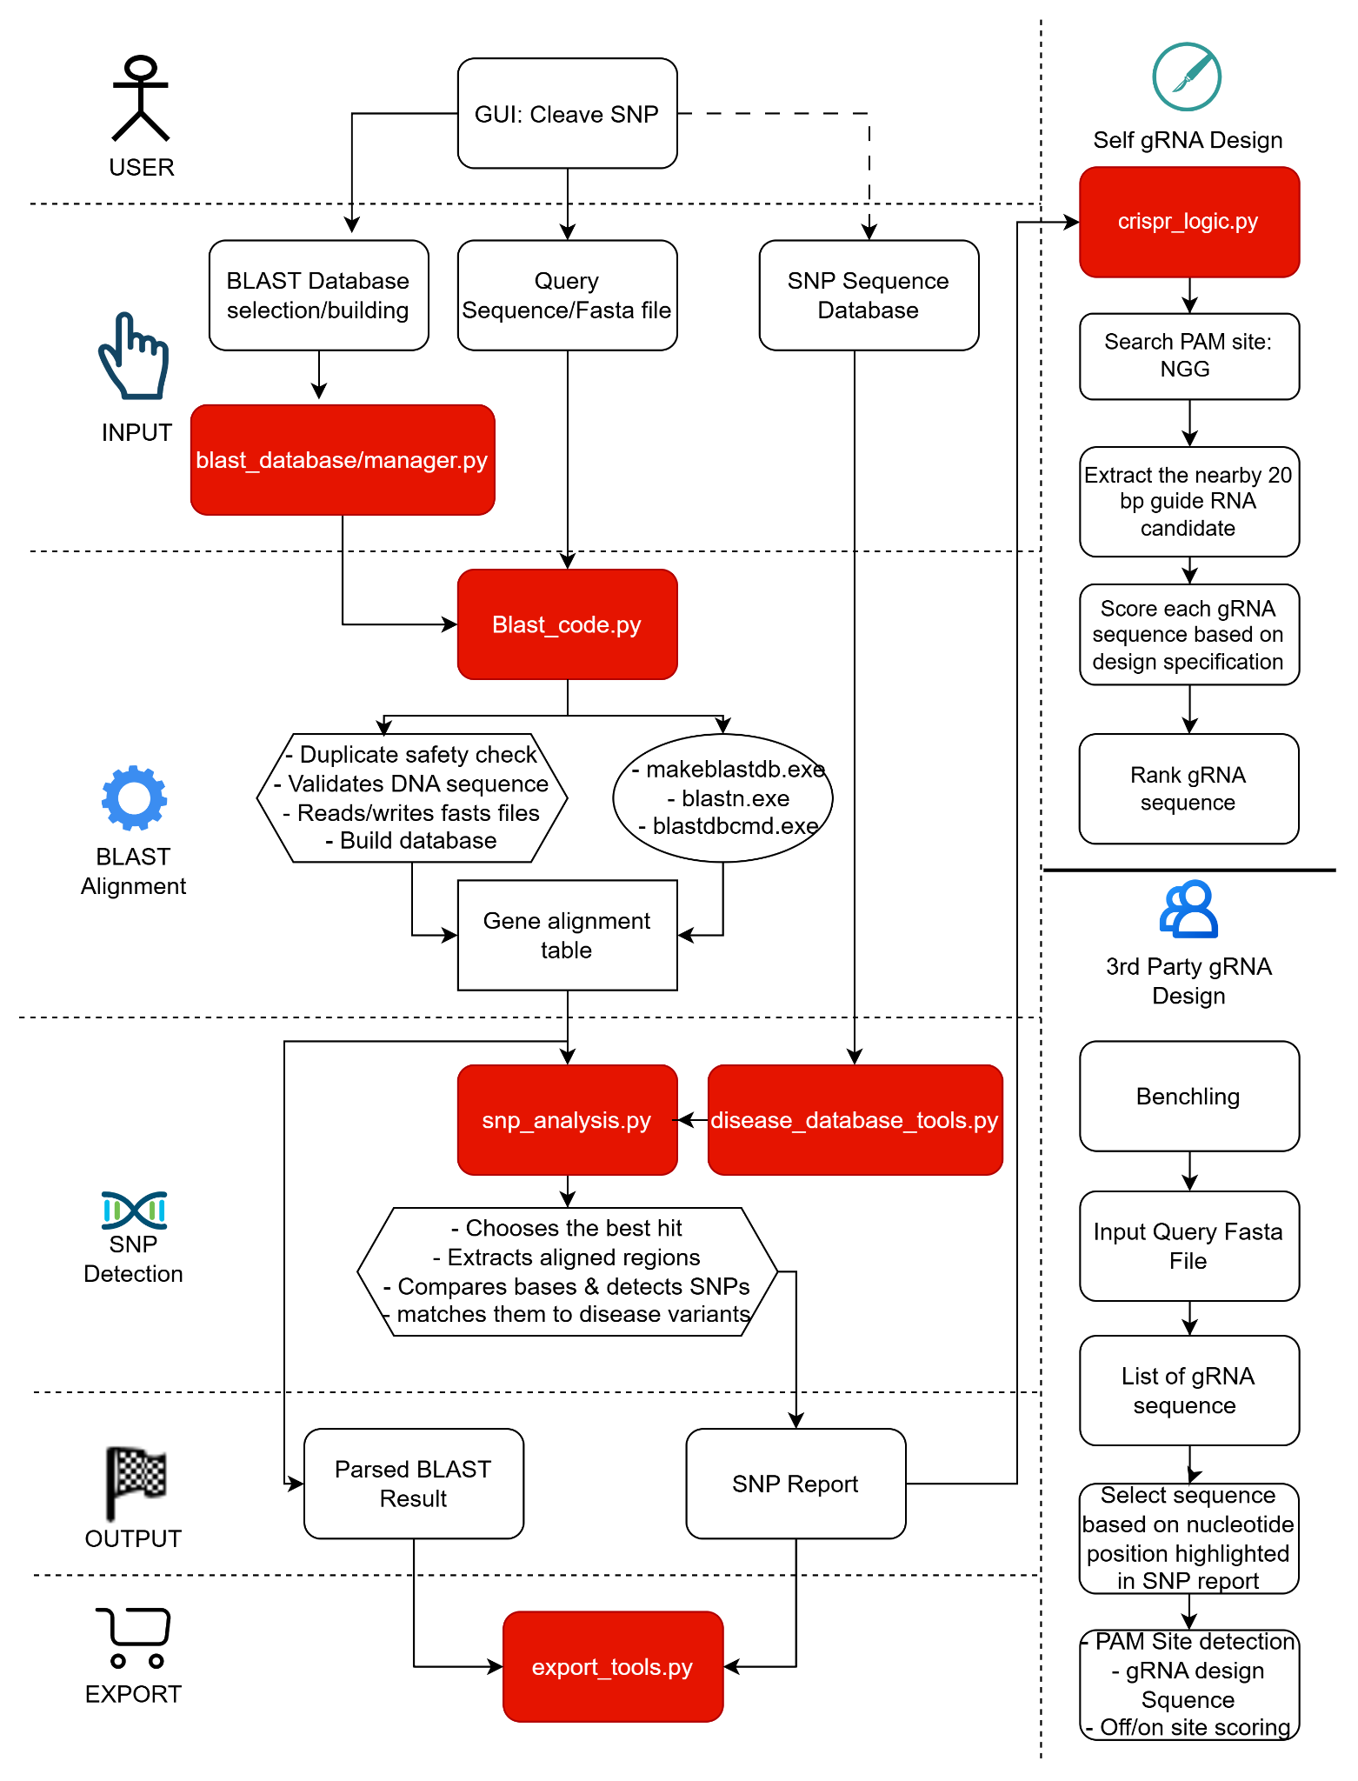
Integrated Detailed Workflow
Within our code we are able to generate GRNA within our website. However, we need to build more on the database to measure its accuracy.
Notes:
ALEX & HEEWON

Slide 6
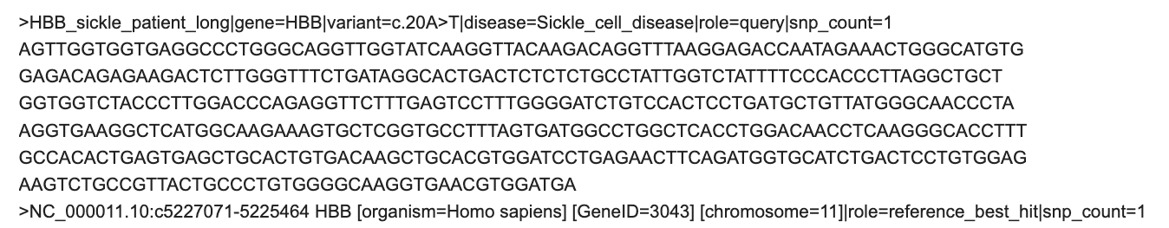
FASTA file
Exported results in FASTA file:
Gene Target (e.g., HBB)
Genomic Coordinates (reference location)
Mutation ID (e.g., c.20A>T)
Target Nucleotide
disease label
Reference Nucleotide: A (within reference sequence)
Homology Arms: Flanking DNA sequences (in both Query and Reference strings)
Exon/Intron Map: Sequence differences between short query and long reference blocks

Slide 7
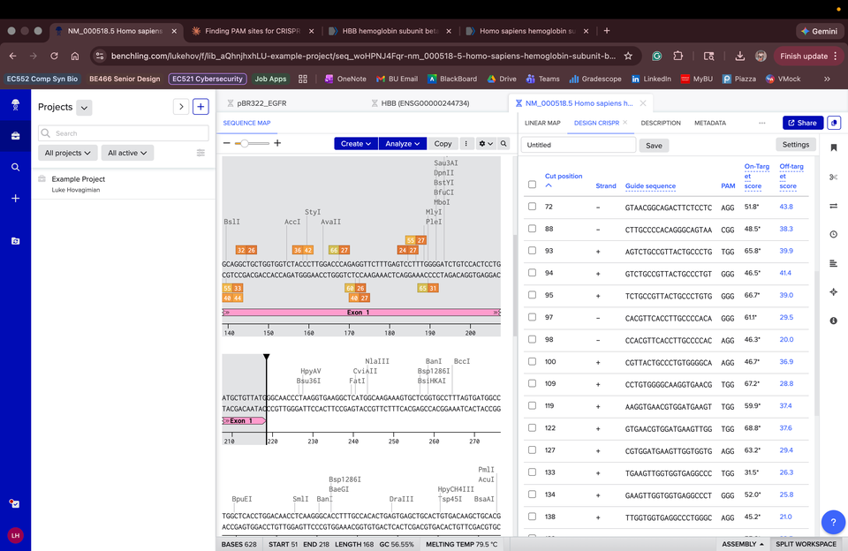
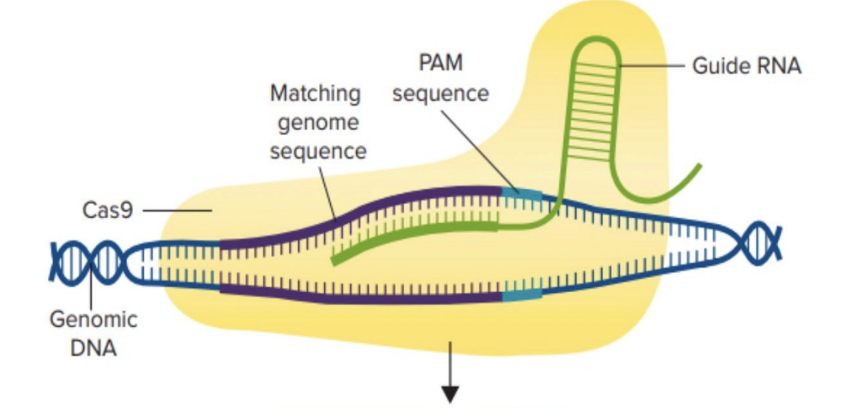
Benchling CRISPR Functionality & Specificity Scoring
Purpose: Import a FASTA file output from web app for running a CRISPR Design Analysis to create a list of viable PAM sites with On/Off-Target Scores and export list as a table to visualize and chose PAM site
Specificity/Efficiency Scoring:
Specificity Score: how likely the guide is to cut somewhere else in the genome by mistake.
Efficiency Score: How efficiently your guide will actually cut at the intended site
Goal: From the list of PAM sites, find a site that sits a decent percentages for both (aim for both to be around or above 60%)
Image: https://platform.cysf.org/media/CRISPR_Cas9_-_The_genetic_scissors_to_treat_Sickle_Cell_Disease1.pdf
Notes:
LUKE

Slide 8
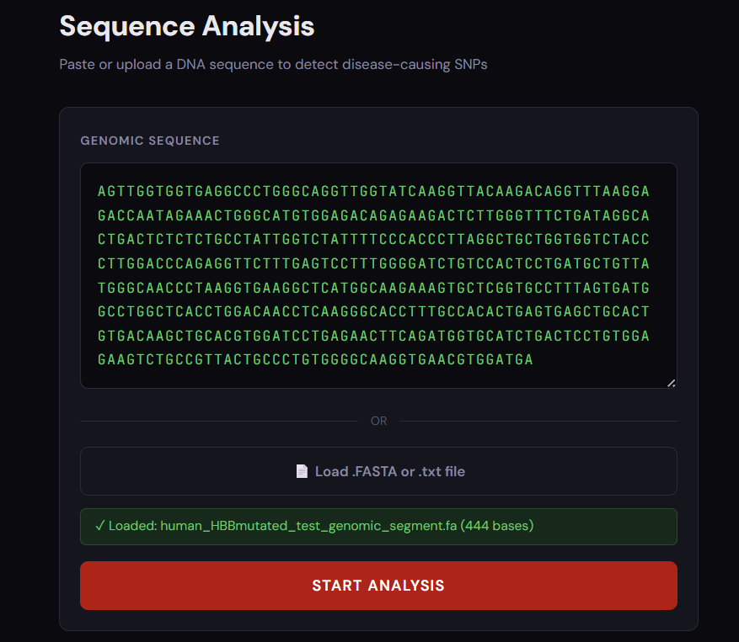
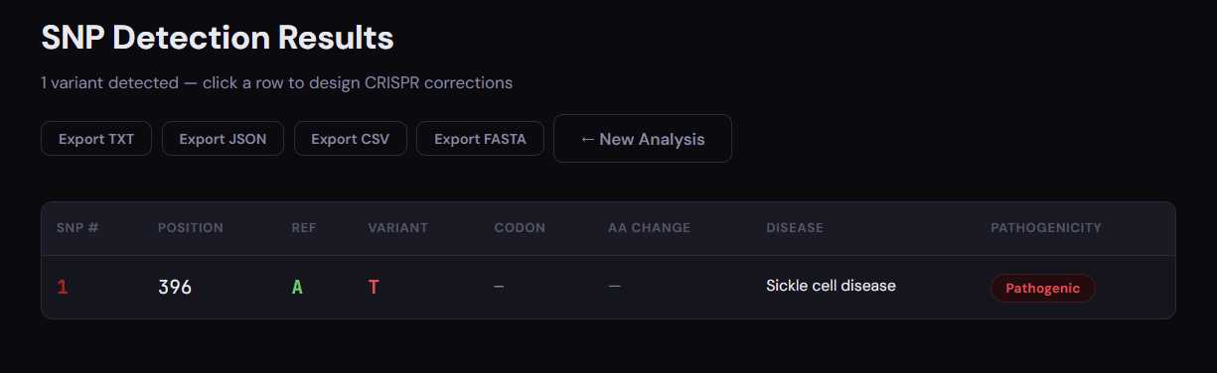
Technical Example – SNP detection
Identified position off by 1 due to python indexing that starts from 0 instead of 1
Notes:
Minh
– DISPLAY THE OUTPUT FROM THE GUI BASED ON THE USER VIEWPOINT

Slide 9
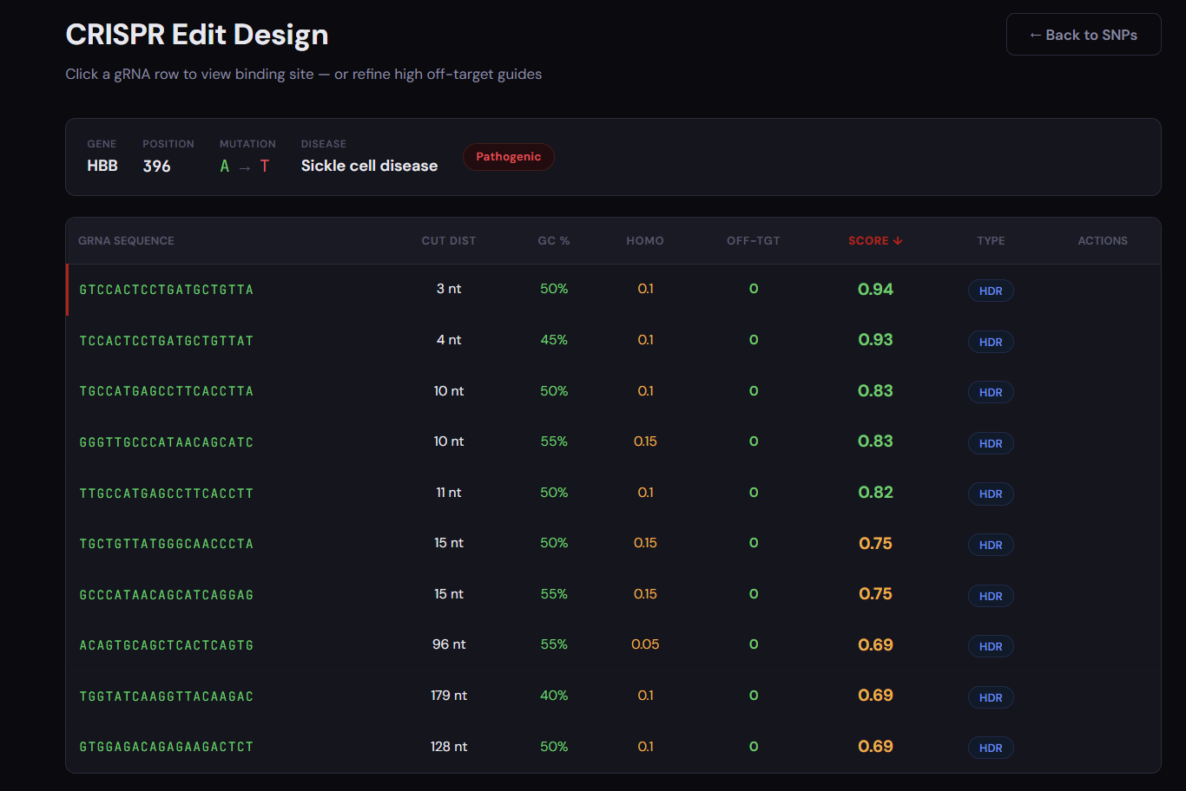
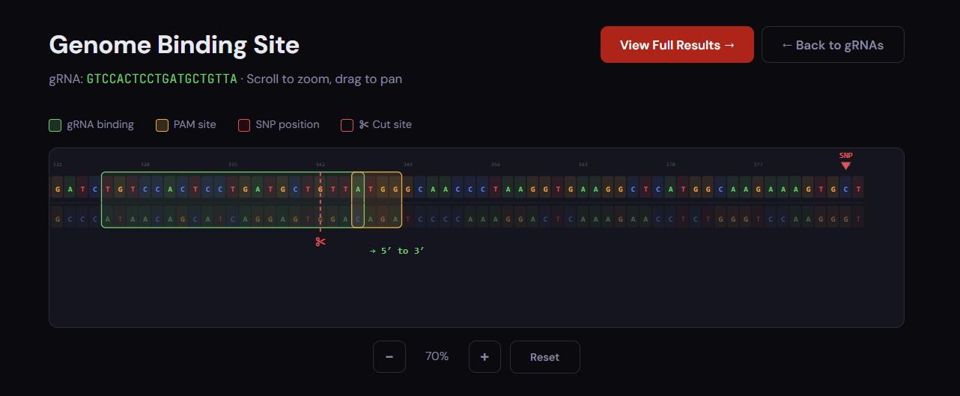
Technical Example – gRNA design
More calibration and tuning needed
Notes:
MIHN/LUKE

Slide 10
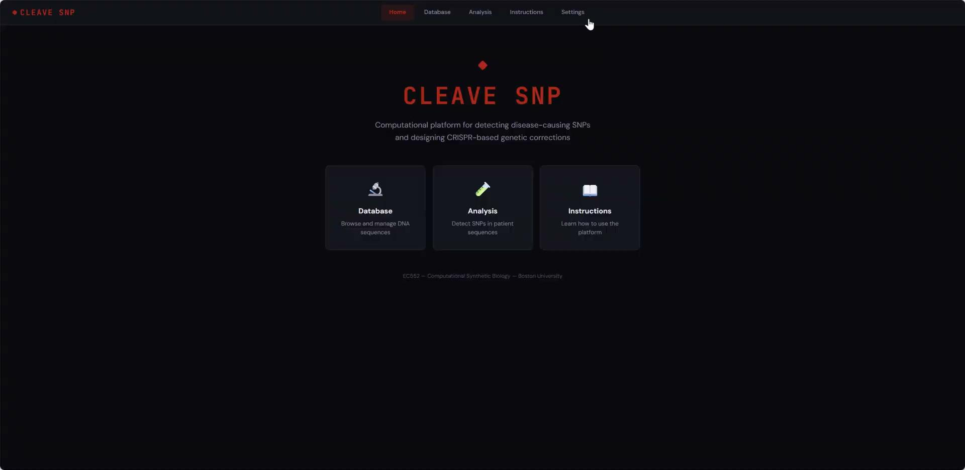
Demo movie
It takes 6 steps:
Configure Blast Bin
Build Database
Input query fasta
Start SNP analysis
gRNA design generation
Visualization of gRNA binding
Our GUI meets the current intuitiveness expectation of <7 steps; having minimal and more concise steps.
https://drive.google.com/file/d/1Zlv9HJRwwX3o1Xl_NMbALaPO3bRwJb7A/view?usp=drive_link
Notes:
MINH
– DISPLAY THE OUTPUT FROM THE GUI BASED ON THE USER VIEWPOINT

Slide 11
Success Analysis
GUI platform functions with integrated python packages and headless BLAST call
BLAST functionality works under constraint conditions
Database handling & safety check capable prevent duplicate and invalid nucleotide letter
Scoring metric of gRNA is accurate on computational level

Slide 12
Failures
Failure | Impact | Potential Solution
BLAST alignment ambiguity/uncertainty | Gaps and shifted boundaries caused SNP-analysis errors | Improve alignment filtering and comparison logic
Reference & SNP disease database dependency | Missing metadata led to unknown variant matches | Standardize and validate sequence records; and
Improvised gRNA workflow | Pivoted to Benchling: guide scoring and visualization were built but not fully tested | Add automated Benchling export parsing and ranking
Self-coded gRNA design module was not validated | Guide sequence, ranking and specificity could not be fully trusted yet | More tuning and calibration needed for gRNA generation & validation. To be assessed against gold-standard gRNA design tools
Notes:
LUKE

Slide 13
Connection to Synthetic Biology Field
Mutation analysis and SNP identification
Target definition for genome editing
Support for downstream gRNA design
Future expansion into circuit design, assembly planning, and protocol design
Foundational core of this project is to serve as mutation-analysis and target-definition tool that bridges sequence analysis with downstream synthetic biology design
Notes:
ALEX

Slide 14
THANK YOU!

